Slide 1

Algebra 1
Unit 2, Lesson 7 Multiplying Binomials and Polynomials Volume 1, pg. 91

Slide 2


Benchmark
MA.912.AR.1.3
Add, subtract, and multiply polynomial expressions with rational number coefficients.
volume 1, pg. 91

Slide 3
Integrated Mathematical Thinking and Reasoning Standards
MA.K12.MTR.2.1 Demonstrate understanding by representing problems in multiple ways.
MA.K12.MTR.3.1 Complete tasks with mathematical fluency.
MA.K12.MTR.4.1 Engage in discussions that reflect on the mathematical thinking of self and others.
volume 1, pg. 91

Slide 4

Learning Targets
I can multiply binomials.
I can multiply polynomials.
volume 1, pg. 91

Slide 5

Warm-Up
volume 1, pg. 92

Slide 6
2.7.1 Warm-Up: Notice and Wonder
The dot plot shows the number of hurricanes that made landfall in the continental United States from 1959 – 2017.
What do you notice when looking at the dot plot?
What do you wonder about the data presented?
1970
1990
Number of Hurricanes 1959 - 2017
1960
1980
2000
2010
volume 1, pg. 92
Notes:
Video Link: https://algebranation.wistia.com/medias/fi4fidi5y8

Slide 7

Guided Instruction
volume 1, pg. 92

Slide 8

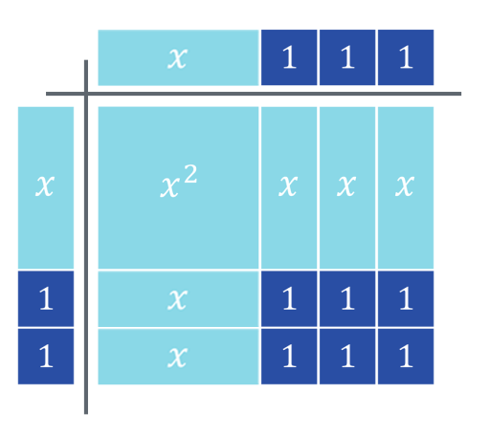
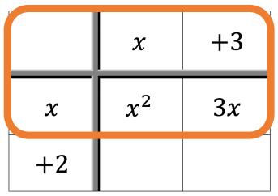
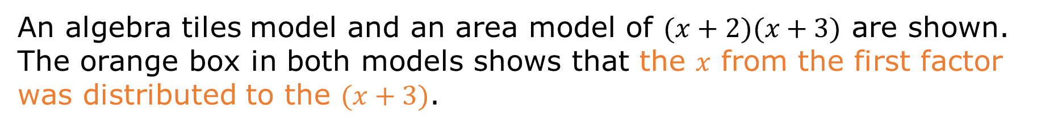
2.7.2 Guided Instruction: Multiplying Binomials
An algebra tiles model and an area model of $(x+2)(x+3)$ are shown. The orange box in both models shows that the 𝑥 from the first factor was distributed to the $(x+3)$.
volume 1, pg. 92

Slide 9
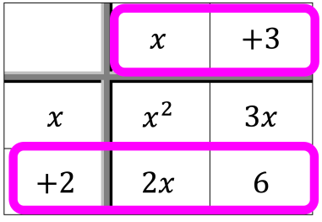
The pink boxes show the $2$ from $(x+2)$ being distributed to the $(x+3)$.
volume 1, pg. 92

Slide 10
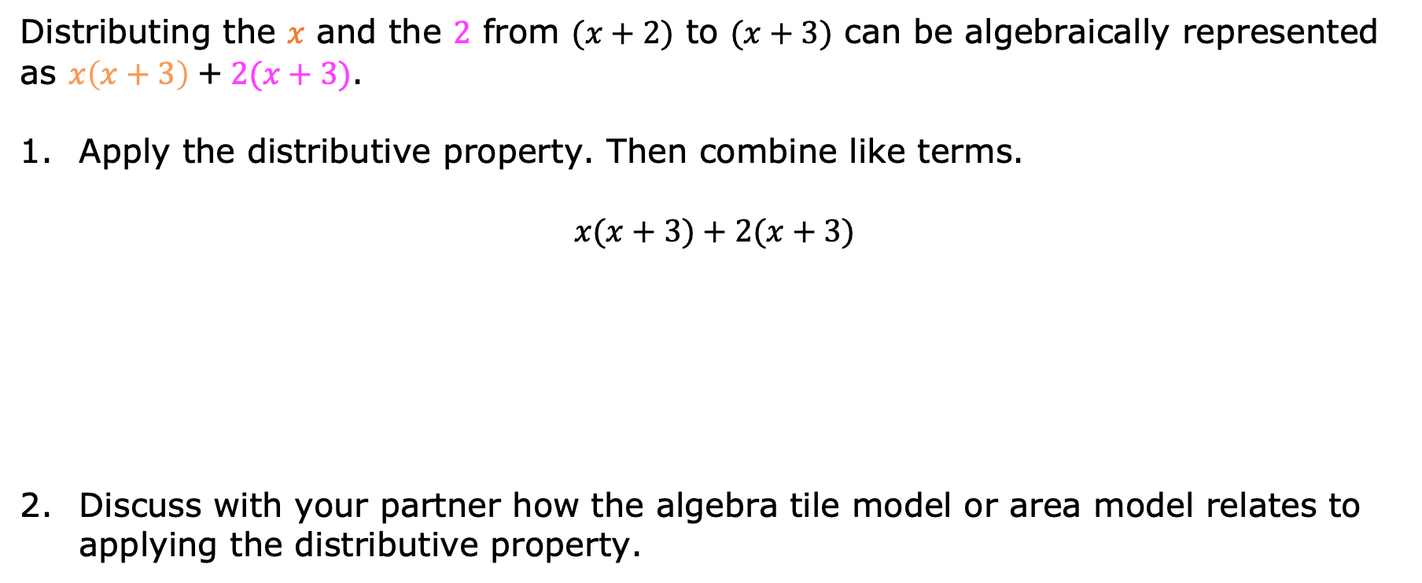
Distributing the 𝑥 and the $2$ from $(x+2)$ to $(x+3)$ can be algebraically represented as $x\left(x+3\right)$+$2(x+3)$.
Apply the distributive property. Then combine like terms.
$$x(x+3)+2(x+3)$$
Discuss with your partner how the algebra tile model or area model relates to applying the distributive property.
volume 1, pg. 93

Slide 11
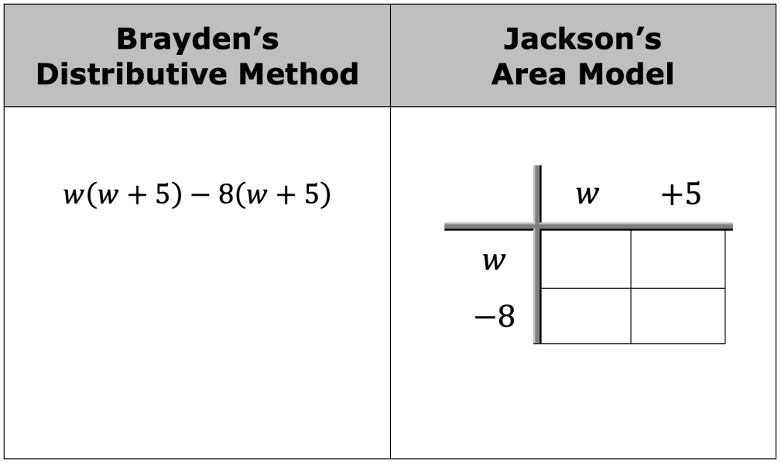
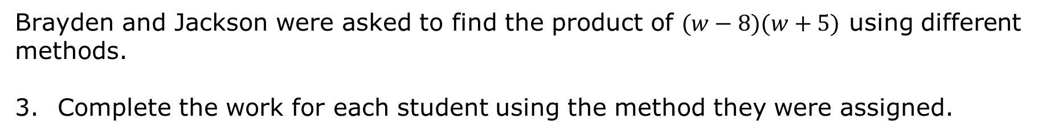
Brayden and Jackson were asked to find the product of $(w−8)(w+5)$ using different methods.
Complete the work for each student using the method they were assigned.
volume 1, pg. 93

Slide 12
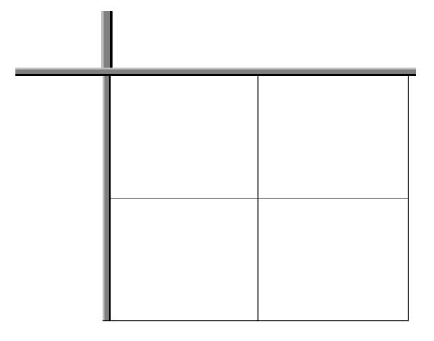
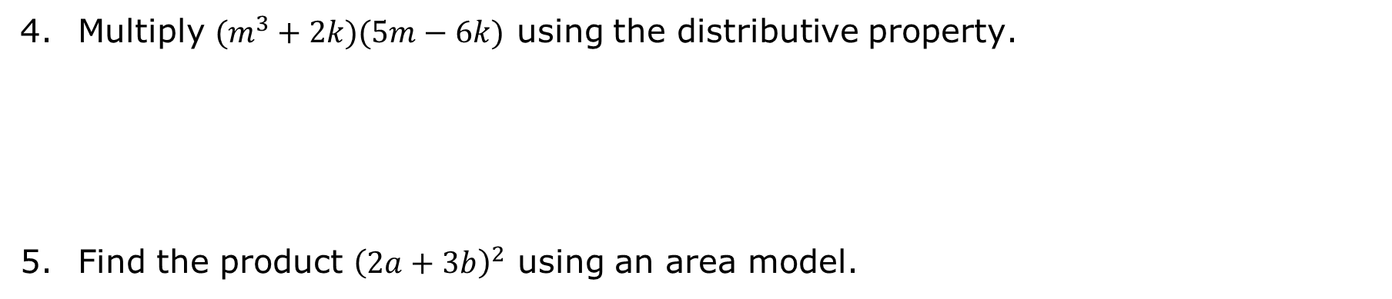
Multiply $(m^{3}+2k)(5m−6k)$ using the distributive property.
Find the product ${\left(2a+3b\right)}^{2}$ using an area model.
volume 1, pg. 93

Slide 13

Guided Practice
volume 1, pg. 94

Slide 14

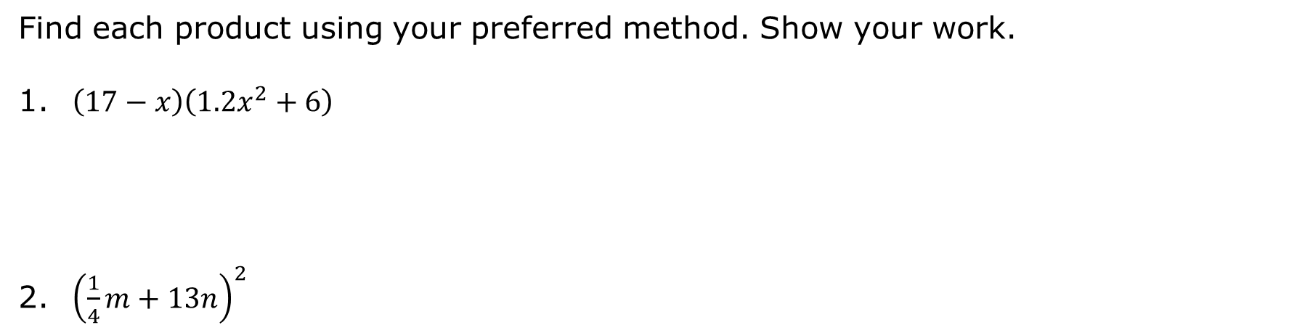
2.7.3 Guided Practice: Multiplying Binomials
Find each product using your preferred method. Show your work.
$\left(17−x\right)\left(1.2x^{2}+6\right)$
${\left(\frac{1}{4}m+13n\right)}^{2}$
volume 1, pg. 94

Slide 15

Collaboration
volume 1, pg. 94

Slide 16

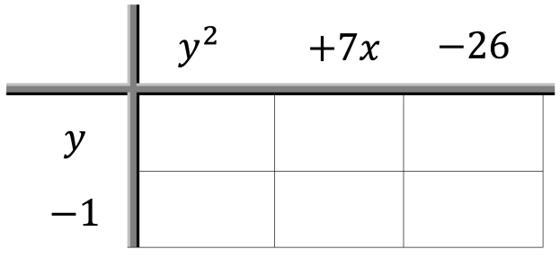

2.7.4 Collaboration: Multiplying Polynomials
The same methods can be extended to multiply any polynomial.
Work with your partner to complete the following.
Multiply $(y−1)(y^{2}+7x−26)$ using the area model.
$\left(y−1\right)\left(y^{2}+7x−26\right)=$__________________
volume 1, pg. 94

Slide 17
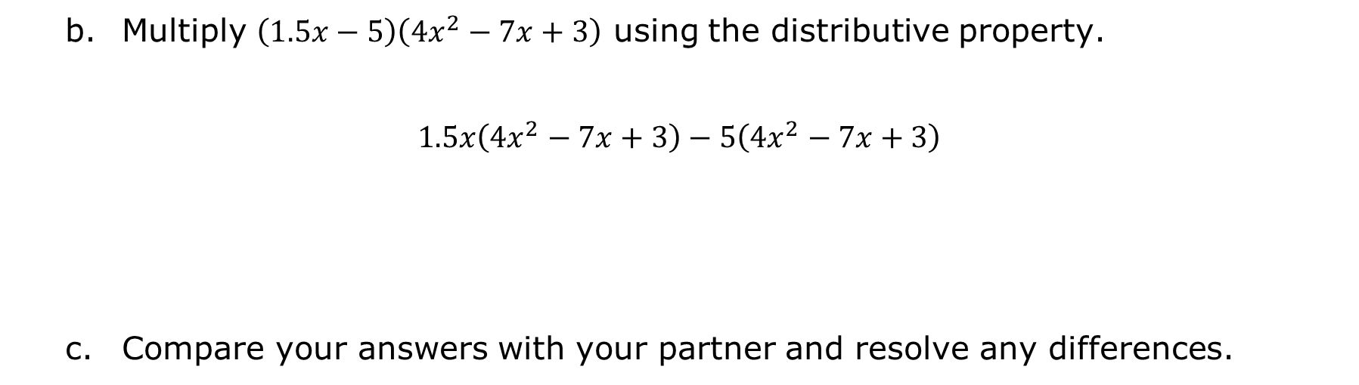
Multiply $\left(1.5x−5\right)\left({4x}^{2}−7x+3\right)$ using the distributive property.
$$1.5x\left({4x}^{2}−7x+3\right)−5\left({4x}^{2}−7x+3\right)$$
Compare your answers with your partner and resolve any differences.
volume 1, pg. 94

Slide 18
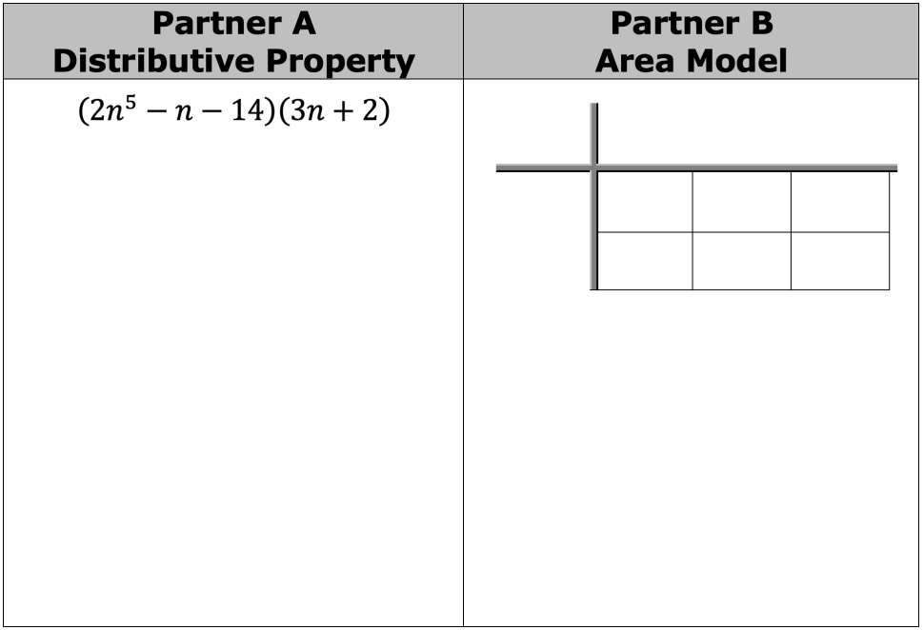
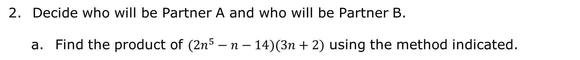
Decide who will be Partner A and who will be Partner B.
Find the product of $(2n^{5}−n−14)(3n+2)$ using the method indicated.
volume 1, pg. 95

Slide 19
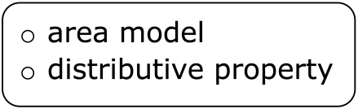
Compare your answers with your partner and resolve any differences.
Discuss any connections you notice between the methods used to find the product.
Complete the statement.
When multiplying polynomials, I prefer to use the because ...
volume 1, pg. 95

Slide 20

Your Turn
volume 1, pg. 95

Slide 21
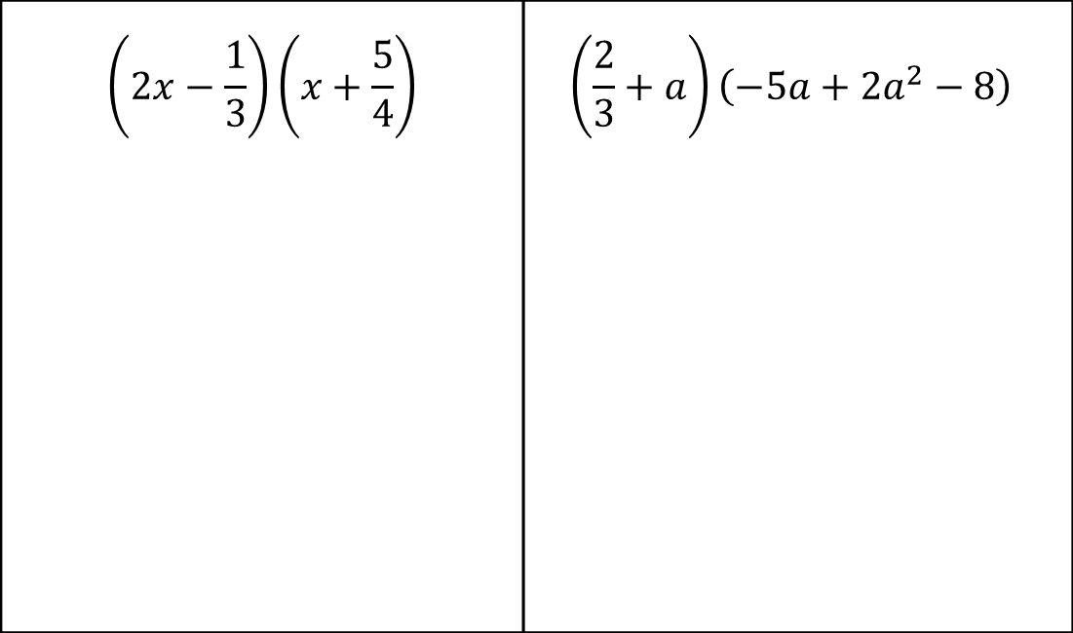
2.7.5 Your Turn!
Find the product of each expression using your preferred method.
$$\left(2x−\frac{1}{3}\right)\left(x+\frac{5}{4}\right)$$ | $$\left(\frac{2}{3}+a\right)\left(−5a+2a^{2}−8\right)$$
volume 1, pg. 95

Slide 22
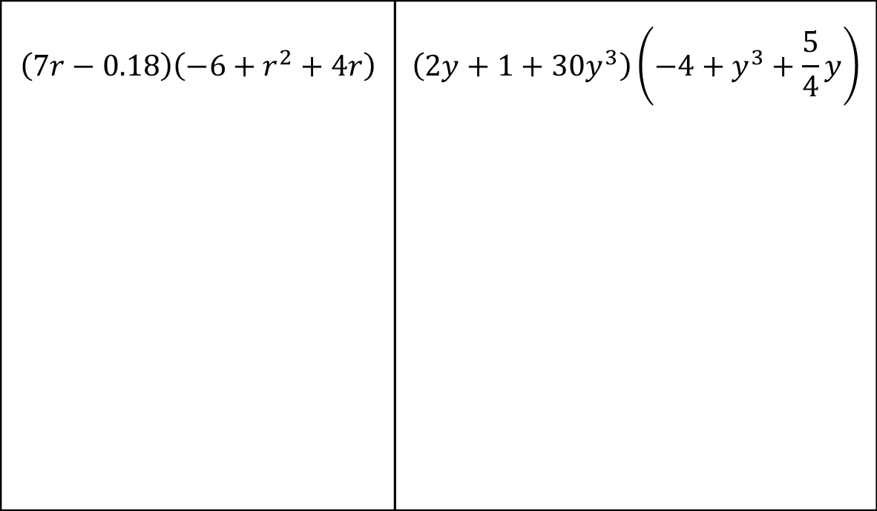
$$\left(7r−0.18\right)\left(−6+r^{2}+4r\right)$$ | $$\left(2y+1+30y^{3}\right)\left(−4+y^{3}+\frac{5}{4}y\right)$$
volume 1, pg. 95

Slide 23

Wrap-Up
volume 1, pg. 96

Slide 24

2.7.6 Wrap-Up: Reflection
How “in the zone” do you feel right now about multiplying polynomials?
volume 1, pg. 96

